Slide 1



Telecom Customer Churn by Shiyam
View in Power BI
Last data refresh:
10/17/2024 4:48:20 PM UTC
Downloaded at:
10/17/2024 4:57:15 PM UTC

Slide 2
Introduction
Customer churn is a critical metric for the telecom industry. It represents the percentage of customers that stop using the company's services over a given period. This report uses data from the company's telecom services to analyze customer churn patterns, identify the factors leading to churn, and suggest actionable insights for reducing it.

Slide 3
Data Overview
Total Customers: 7,043
Churned Customers: 1,869 (Churn Rate: [26.54 %])
Data Source: MySQL and Power BI Desktop report on telecom customer churn

Slide 4
Data Cleaning Process for Telecom Customer Churn
Remove Duplicates: Eliminate duplicate records using the customer ID.
Handle Missing Data:
Impute missing values (mean, median, or mode).
Mark missing categorical data as "Unknown."
Standardize Data: Ensure consistency in formats (e.g., dates, numbers, text).
Fix Errors: Correct spelling, inconsistent labels, and data entry errors.
Outlier Detection: Identify and treat outliers in numeric data.
Fix Data Types: Ensure correct data types for all columns.
Drop Irrelevant Columns: Remove unnecessary features (e.g., ZIP code, Customer ID).
Validate: Review and validate the cleaned data for consistency.

Slide 5
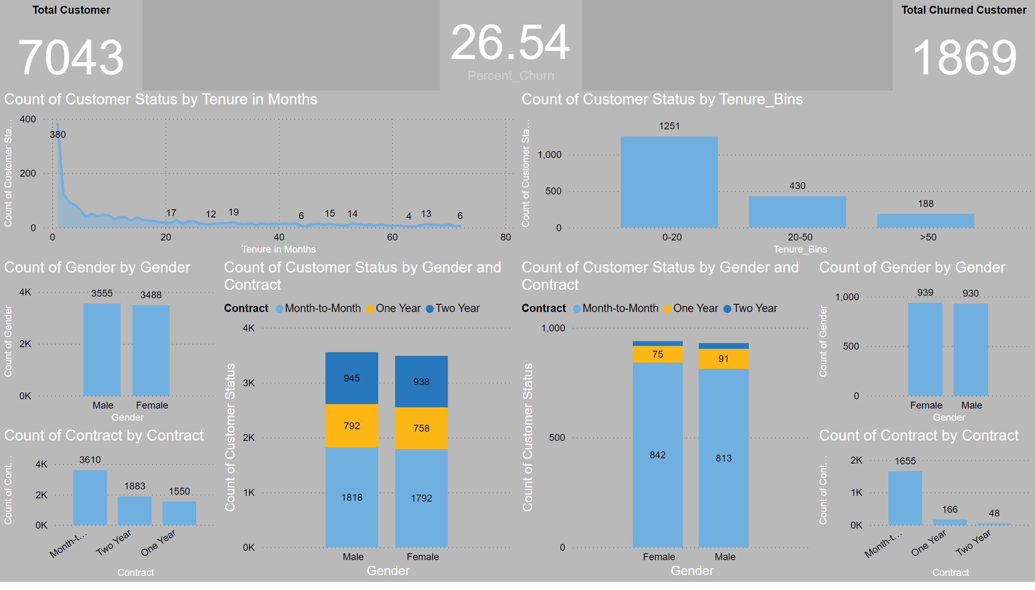
EDA
Notes:
columnChart
No alt text provided
columnChart
No alt text provided
columnChart
No alt text provided
columnChart
No alt text provided
card
No alt text provided
card
No alt text provided
card
No alt text provided
columnChart
No alt text provided
columnChart
No alt text provided
areaChart
No alt text provided
columnChart
No alt text provided

Slide 6
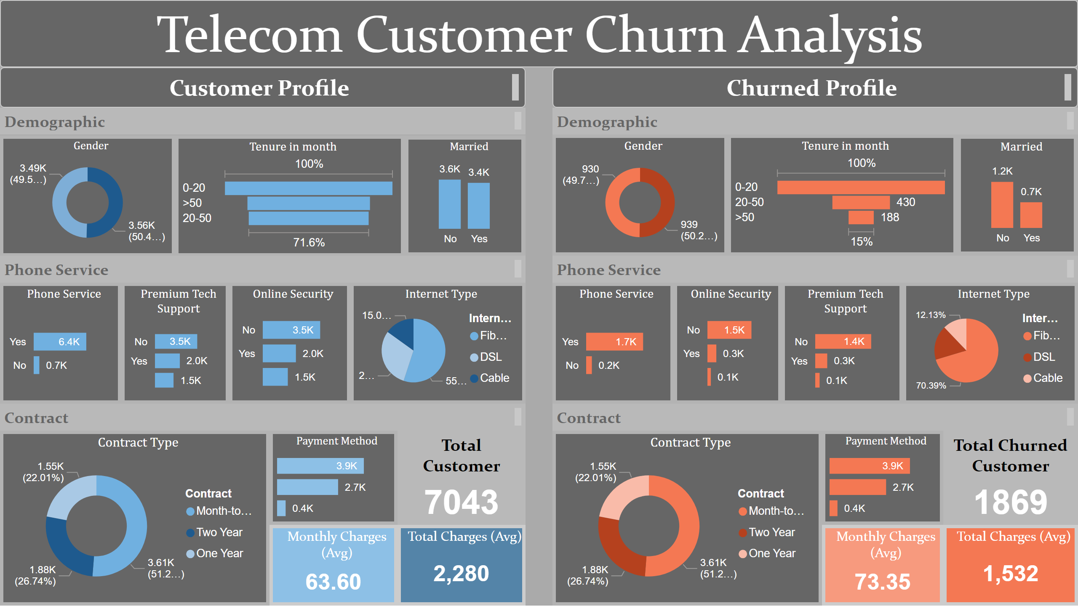
Dashboard
Notes:
Gender
No alt text provided
Tenure in month
No alt text provided
Married
No alt text provided
Married
No alt text provided
Tenure in month
No alt text provided
Gender
No alt text provided
Phone Service
No alt text provided
Online Security
No alt text provided
Premium Tech Support
No alt text provided
Internet Type
No alt text provided
Phone Service
No alt text provided
Online Security
No alt text provided
Premium Tech Support
No alt text provided
Internet Type
No alt text provided
Contract Type
No alt text provided
Payment Method
No alt text provided
Payment Method
No alt text provided
Contract Type
No alt text provided
Monthly Charges (Avg)
No alt text provided
Total Charges (Avg)
No alt text provided
Total Charges (Avg)
No alt text provided
Monthly Charges (Avg)
No alt text provided
Telecom Customer Churn Analysis
No alt text provided
textbox
No alt text provided
textbox
No alt text provided
textbox
No alt text provided
textbox
No alt text provided
textbox
No alt text provided
textbox
No alt text provided
textbox
No alt text provided
textbox
No alt text provided
card
No alt text provided
card
No alt text provided

Slide 7
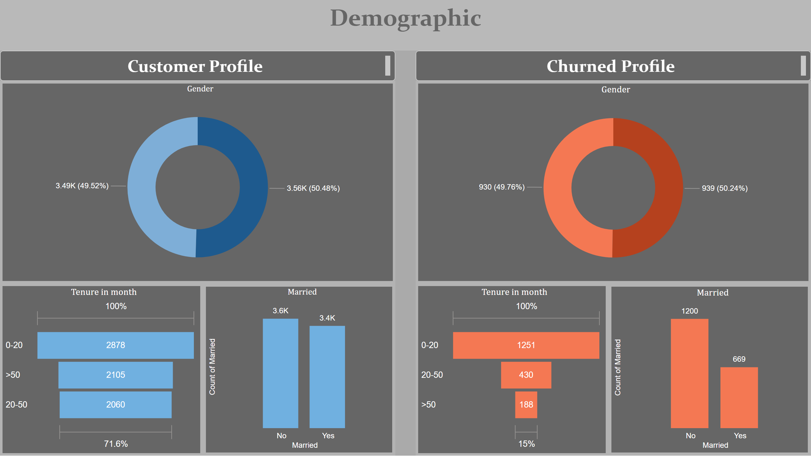
Demographic Charts
Notes:
textbox
No alt text provided
textbox
No alt text provided
textbox
No alt text provided
Gender
No alt text provided
Tenure in month
No alt text provided
Married
No alt text provided
Married
No alt text provided
Tenure in month
No alt text provided
Gender
No alt text provided

Slide 8
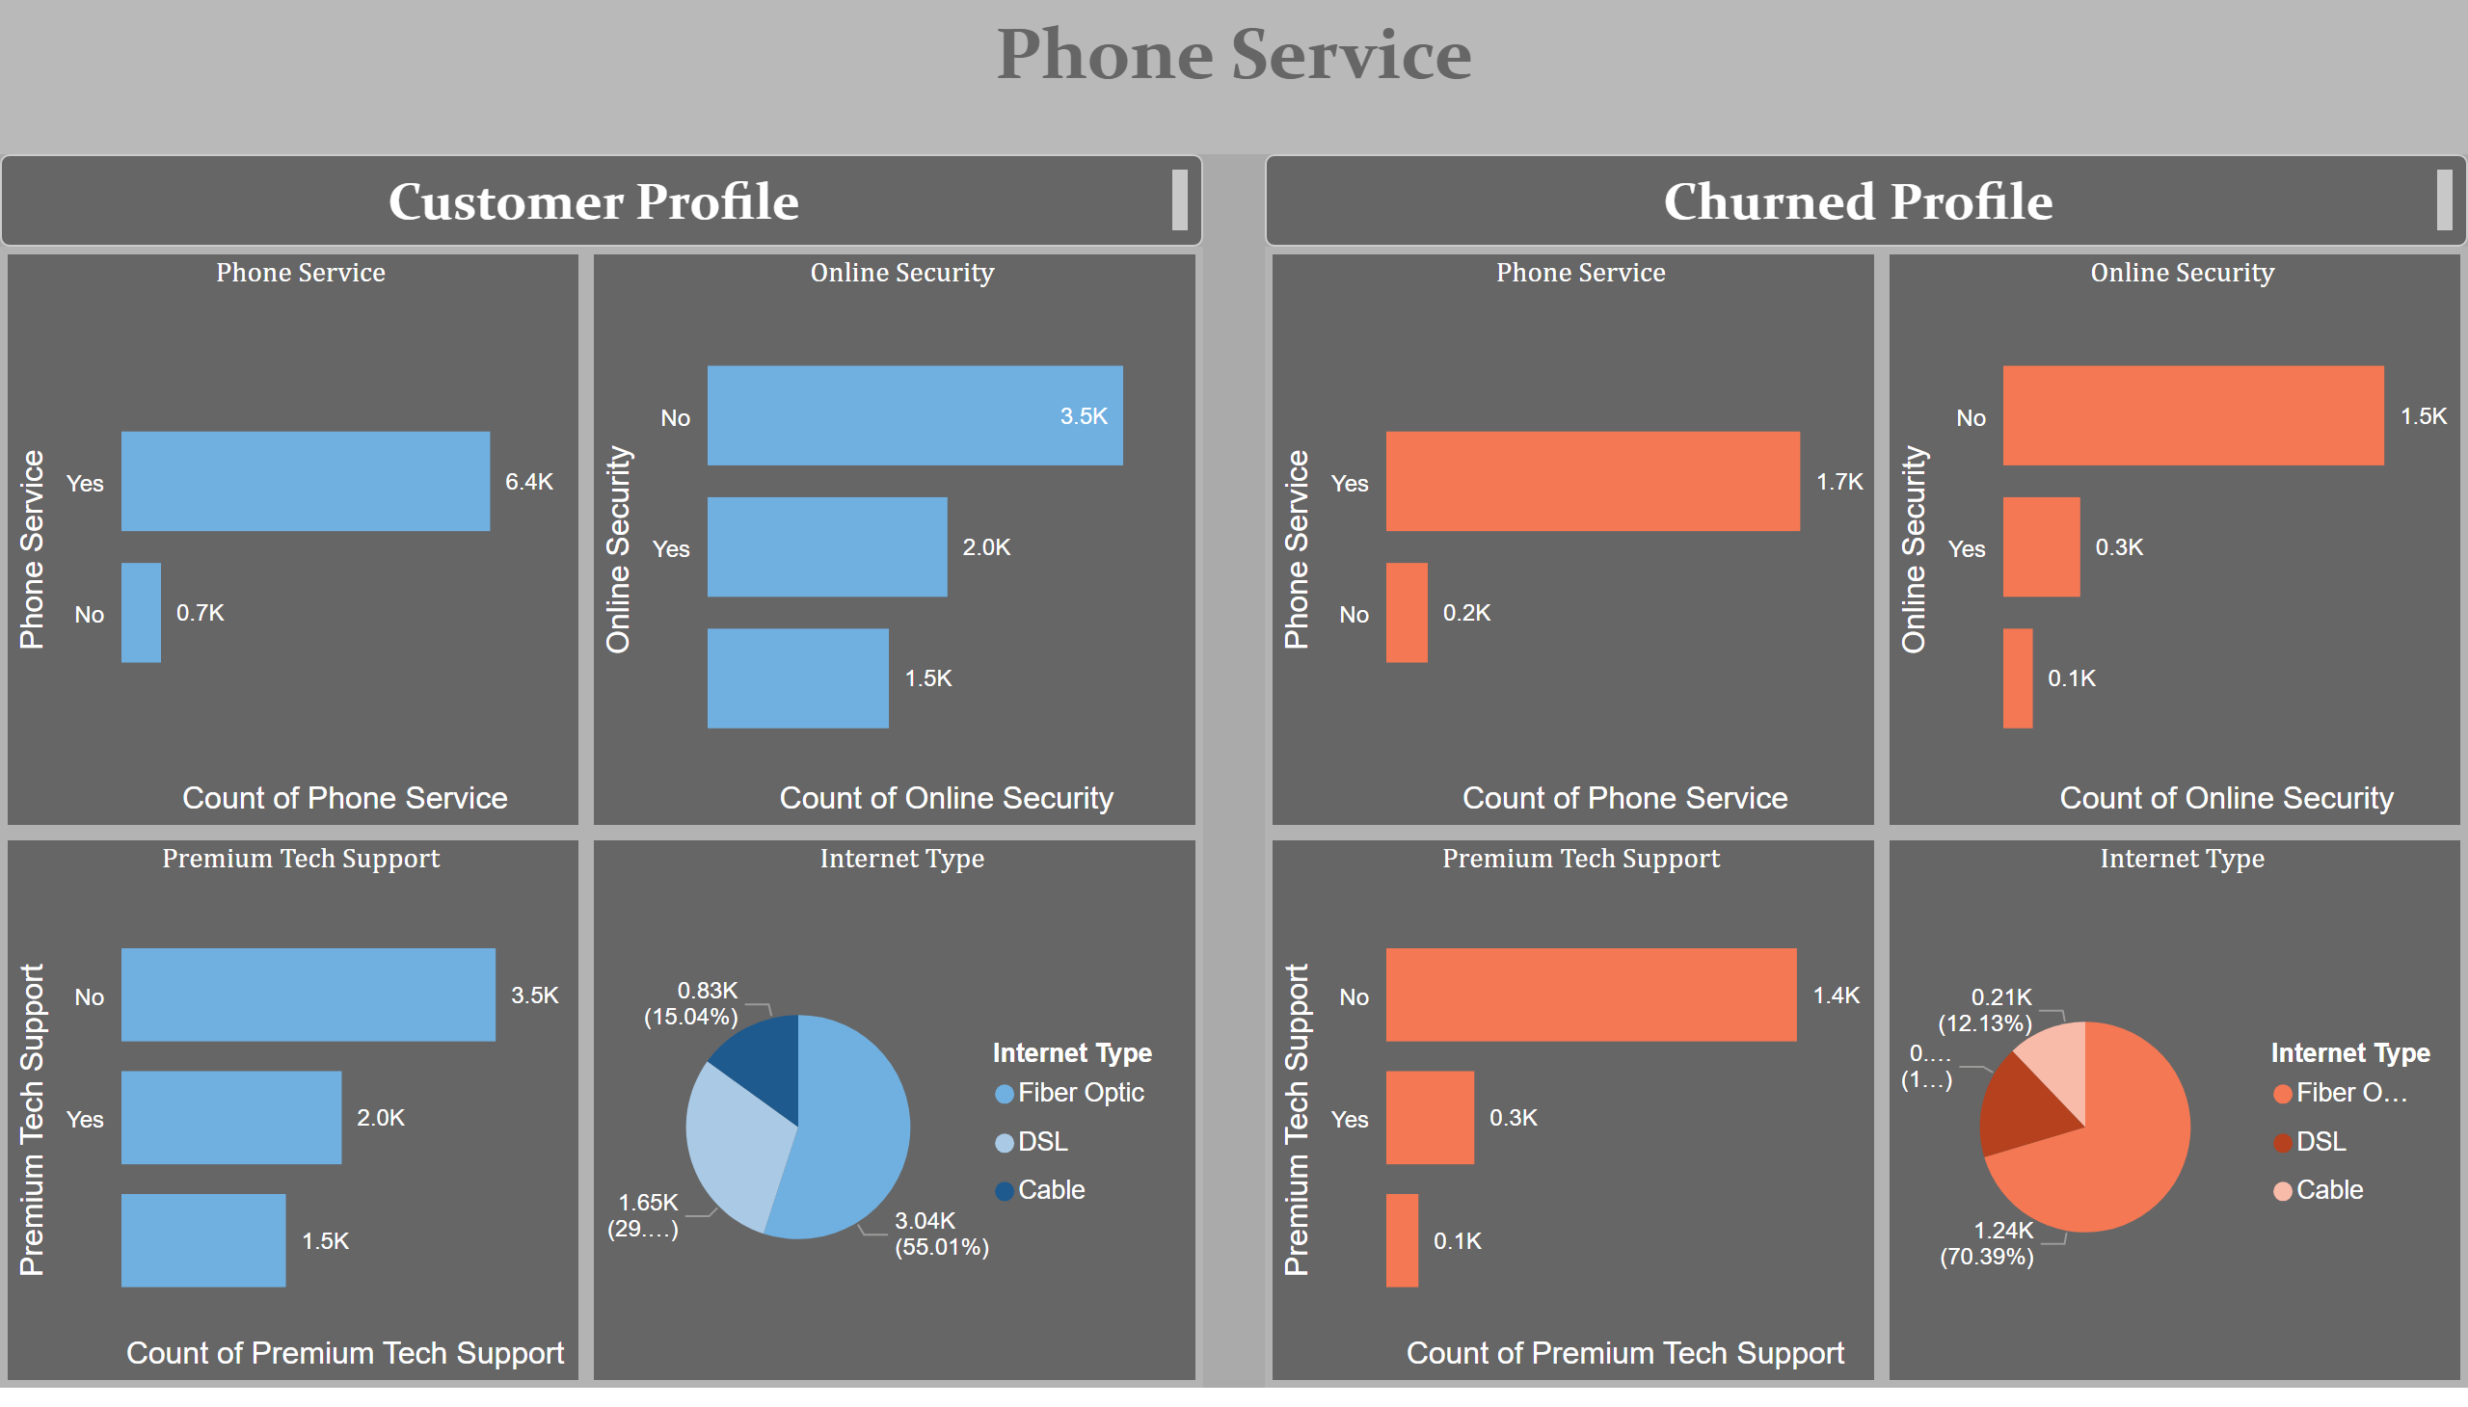
Phone Service Chart
Notes:
textbox
No alt text provided
textbox
No alt text provided
textbox
No alt text provided
Phone Service
No alt text provided
Premium Tech Support
No alt text provided
Online Security
No alt text provided
Internet Type
No alt text provided
Phone Service
No alt text provided
Online Security
No alt text provided
Premium Tech Support
No alt text provided
Internet Type
No alt text provided

Slide 9
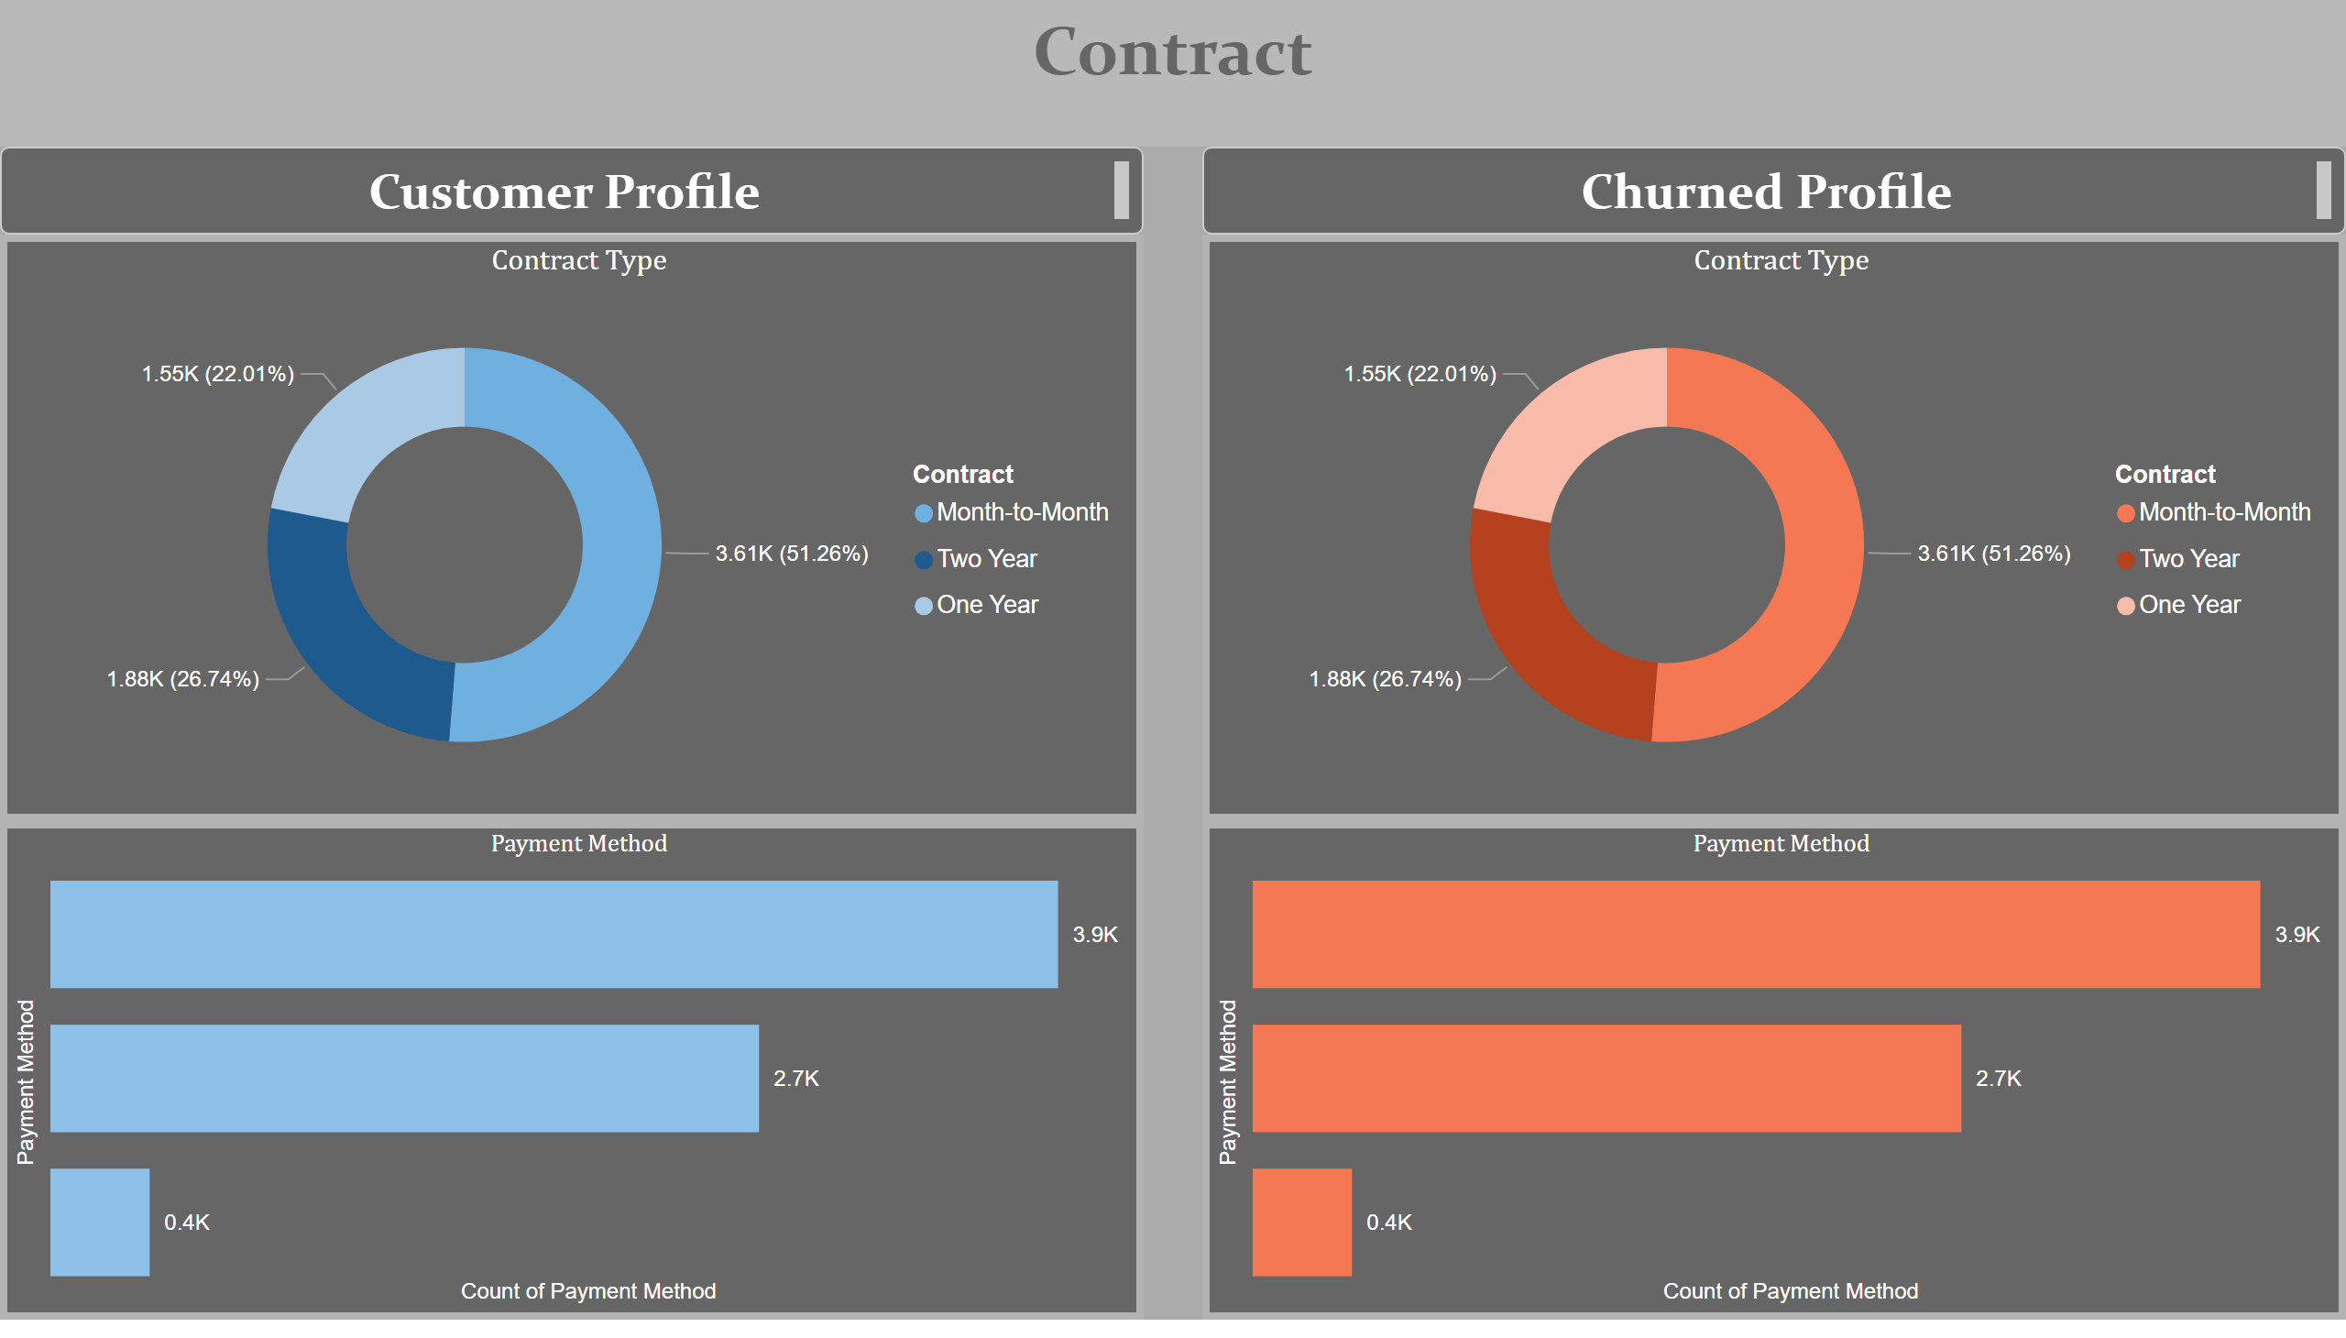
Contract Chart
Notes:
textbox
No alt text provided
textbox
No alt text provided
textbox
No alt text provided
Contract Type
No alt text provided
Payment Method
No alt text provided
Contract Type
No alt text provided
Payment Method
No alt text provided

Slide 10
Findings
Month-to-month contracts have a significantly higher churn rate, suggesting that these customers require more attention.
Customers with longer contracts, such as One Year and Two Year, show relatively lower churn rates.
Customers with shorter tenures, particularly those who have used the service for 0-10 months, tend to churn more, while customers with tenures above 50 months churn significantly less.
Customers using Fiber optic internet services show a higher propensity to churn compared to those using DSL or Cable.
There is a strong correlation between churn and the absence of online security and tech support services; customers without these services churn more frequently.
Customers without online backup, device protection, or technical support tend to have higher churn rates.
Customers who use Bank Withdrawal as a payment method are more likely to churn compared to those using credit cards.

Slide 11
Recommendations:
Focus on month-to-month contract customers by offering better retention strategies.
Address churn drivers by enhancing fiber optic internet services, offering online backups, tech support, and device protection to improve customer satisfaction.
Consider reviewing the bank withdrawal payment method, as it is associated with higher churn.
Month to month contract should be given more attention as customers that have subscribed for that tend to churn.
Customers who have used between 0 to10 months tend to churn.
Customer using Fiber optic internet service tend to churn.
Customers using Bank Withdrawal payment method tend to churn.
Customers without online backup churn more.
Customers without Tech support churn more.
Customers without device protection tend to churn more.

Slide 12
Conclusion
The analysis reveals that customer churn is significantly affected by contract type, tenure, internet service, and the availability of value-added services. Addressing these issues through targeted retention strategies, enhancing customer service, and incentivizing long-term contracts can reduce churn and improve customer loyalty.

